Slide 1

SPONSORSHIP PACKAGES
Nov 4-6, 2026
Mexicali, Baja California, México

Slide 2

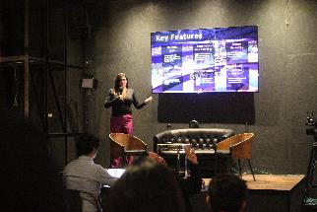
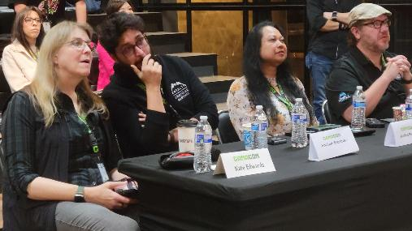
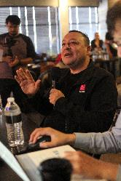
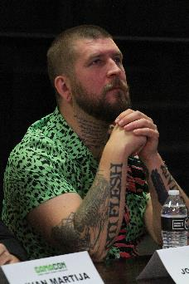
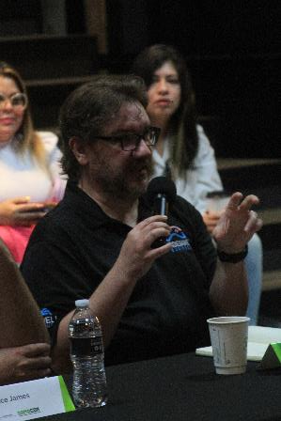
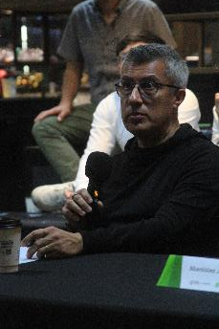
VG Elevator Pitch

Slide 3
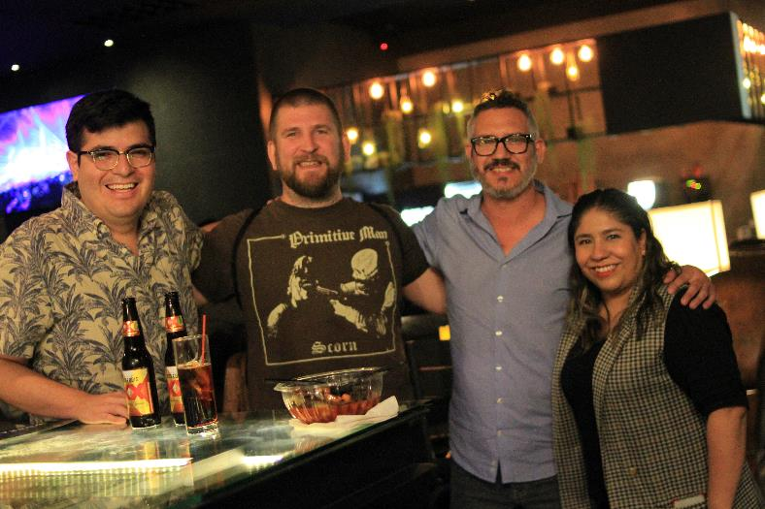
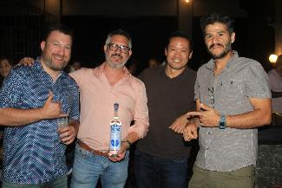
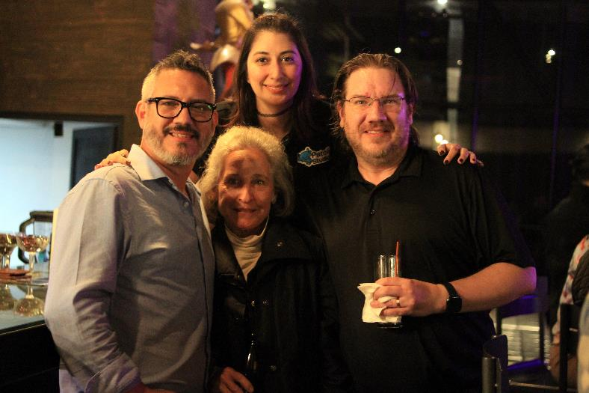
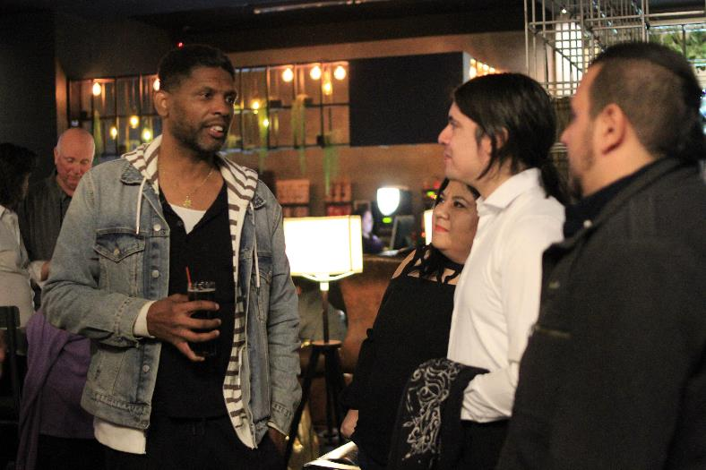
Business Mixer

Slide 4
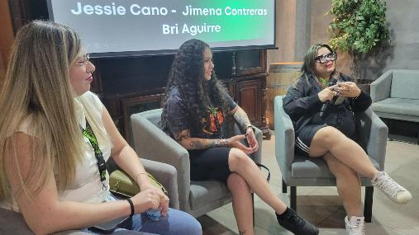
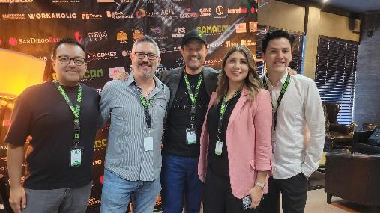
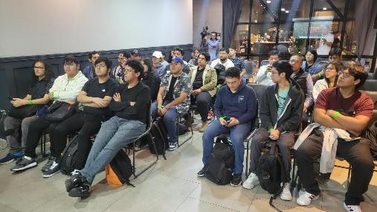
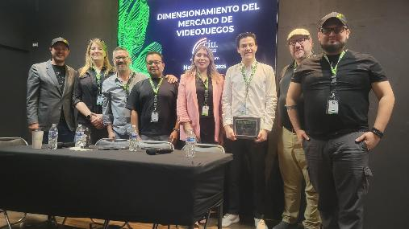
Conferences

Slide 5
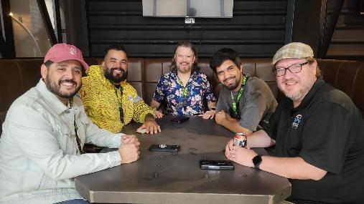
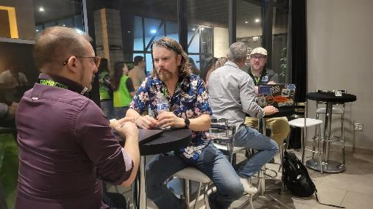
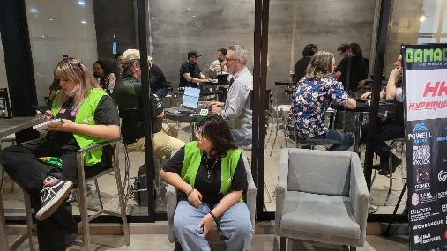
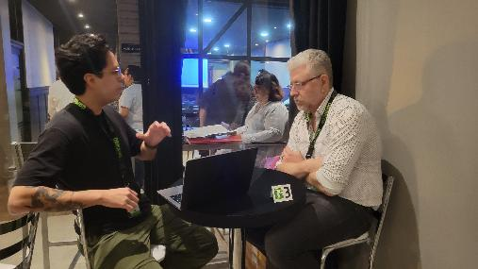
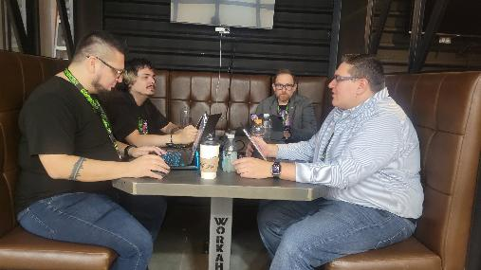
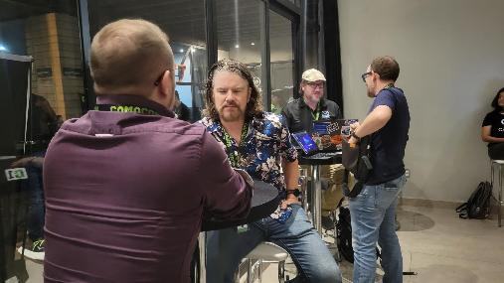
B2B - MeetToMatch

Slide 6
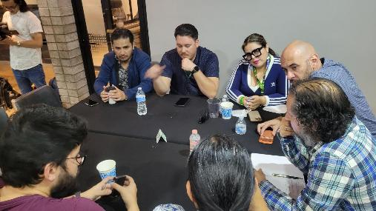
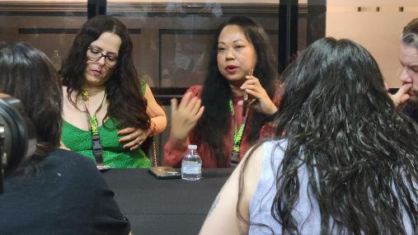
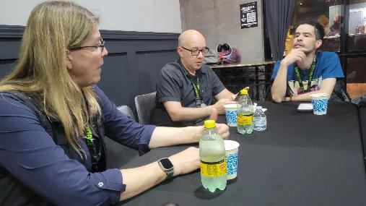
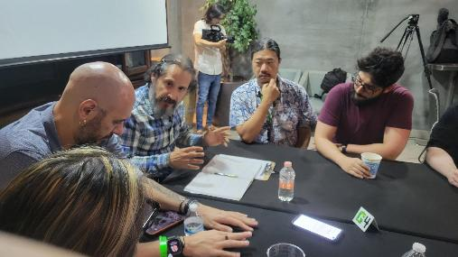
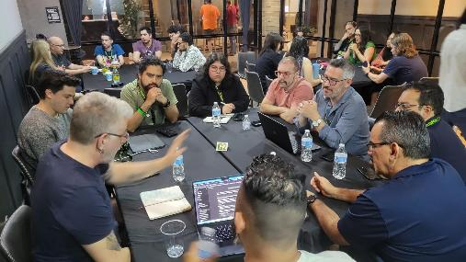
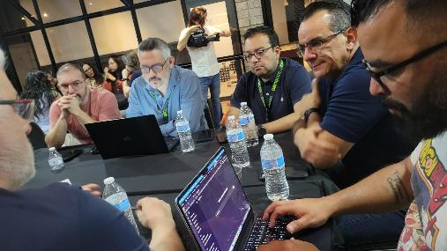
Round tables w/ Government

Slide 7
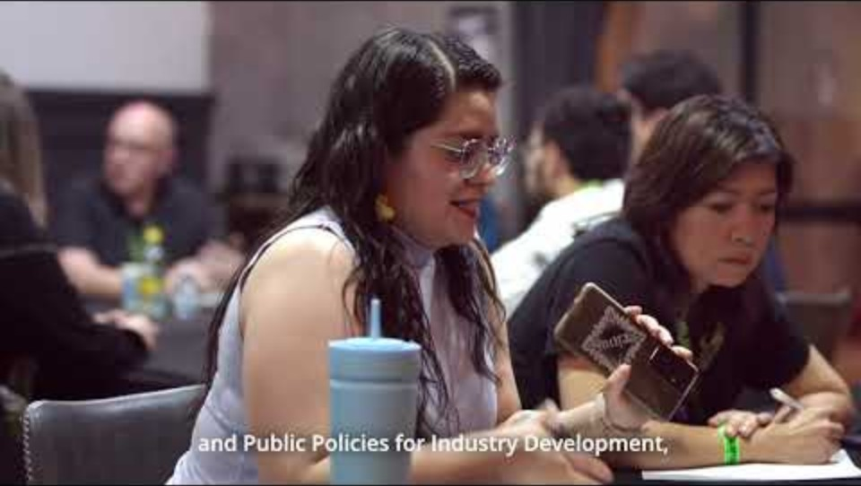
2025 promotional video
https://youtu.be/_tm_VfTHNAg?si=G64YdkyGskh8wzbJ

Slide 8
DIAMOND SPONSOR
Your logo shown (giant size) on all banners, posters, flyers, website
Individual & detailed post of your company on social media
Mentioned in all interviews (radio & TV)
Access to VIP areas (ex. Wine tasting event, break rooms with appetizers & drinks)
5 full badges
Include promotional goodies at event entrance
Have promotional items on different parts of the event (X-banners, postcards, keyrings, etc)
Participate in the business mixer, VG elevator pitch, MeetToMatch, round tables, conferences, padel tournament
Participate at the press conference
Participation fee: $7,500 $5,000 USD

Slide 9
GOLD SPONSOR
Your logo shown (big size) on all banners, posters, flyers, website
Individual post of your company on social media
Access to VIP areas (ex. Wine tasting event, break rooms with appetizers & drinks)
4 full badges
Include promotional goodies at event entrance
Have promotional items on different parts of the event (X-banners, postcards, keyrings, etc)
Participate in the business mixer, VG elevator pitch, MeetToMatch, round tables, conferences, padel tournament
Participation fee: $5,500 $3,500 USD

Slide 10
SILVER SPONSOR
Your logo shown (medium size) on all banners, posters, flyers, website
Group with others post of your company on social media
2 full badges
Include promotional goodies at event entrance
Have promotional items on different parts of the event (X-banners, postcards, keyrings, etc)
Participate in the business mixer, VG elevator pitch, MeetToMatch, round tables, conferences, padel tournament
Participation fee: $3,000 $2,000 USD

Slide 11
BRONZE SPONSOR
Lunch/Drinks Host
Your logo shown (small size) on all banners, posters, flyers, website
Group with others post of your company on social media
Include promotional goodies at event entrance
Have promotional items on different parts of the event (X-banners, postcards, keyrings, etc)
Participation fee: $1,500 $1,000 USD

Slide 12
SUMMARY

Slide 13

Gamacon 2025 marketing material
Photo wall

Slide 14



Gamacon 2025 marketing material
X-banners

Slide 15



Gamacon 2025 marketing material
X-banners

Slide 16
THANK YOU!
We look forward to seeing you at…
Contact
Hugo Abel Castro
Founding President
hcastro@gamacon.mx
+52 686 160-8739
www.gamacon.mx Fb: Gamacon.oficial

